Slide 1
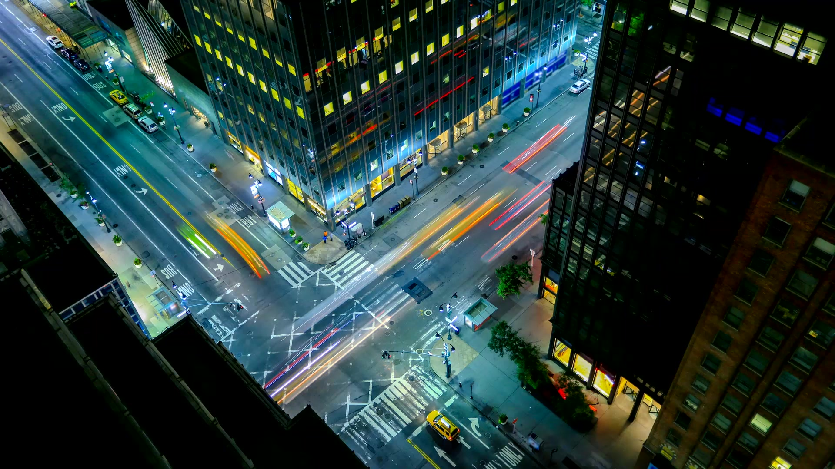
Car Accident Severity Prediction

Slide 2
Problem Statement
The problem present here with us is with increase in use of cars and newer technologies that are coming up the number of accidents is getting multifold. According to certain reports Seattel city of US is amongst the tops cities in number of accidents in world. In these accidents many precious lives are lost and property worth millions are damaged. We need to find a way if we can reduce number of accidents and with that reduce the loss of lives and property. We have the data for the accidents that have occurred in the city from year 2004 with various attributes assigned to it such as when the accident occurred date-time what were the road, light and weather conditions, was the drives under the influence of alcohol, did the accident result in property damage only or there were Injuries to people.
From this data we can think of predicting the severity of accident if it will occur would it result in property damage or Injuries and how sever it would be. We can use this to restrict speed limit on certain days when there are high chances of sever accident. We can use this to transmit messages across the city that there are probabilities that an accident can occur please drive safely. And sign boards where there are more accident happening – an Accident-prone zone. Basically, we can apply stricter laws and take various precautions so that the numbers of accident are reduced.
We will create a machine learning model to perform our task of predicting accident severity based on various conditions.

Slide 3
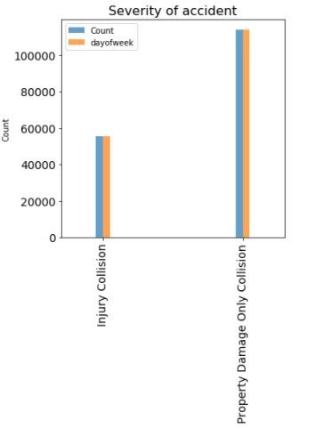
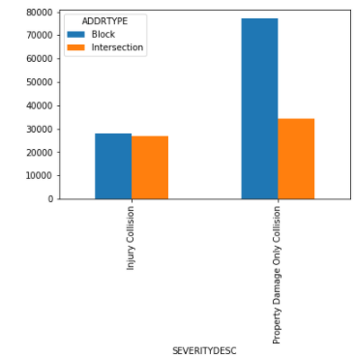
Data Visualization
Accident severity by count
Accident severity by junction type

Slide 4
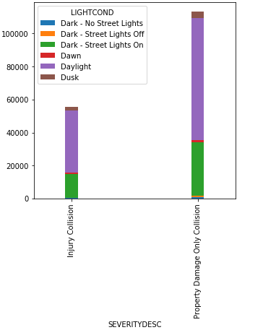
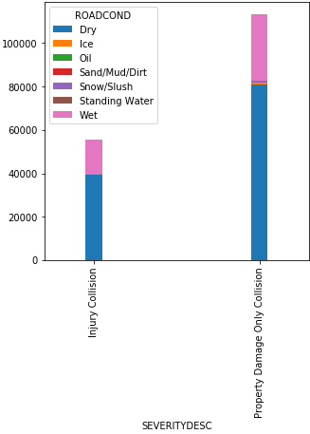
Data Visualization
Accident severity by Light Condition
Accident severity by Road Condition

Slide 5
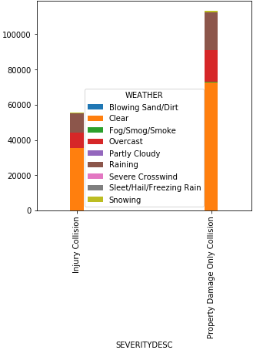
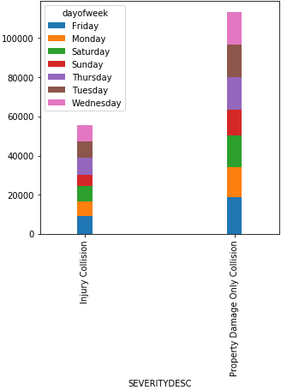
Data Visualization
Accident severity by Weather Condition
Accident severity by Day of Week

Slide 6
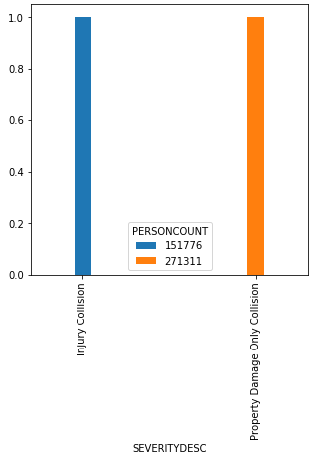
Data Visualization
Accident Severity and person involves in it.

Slide 7
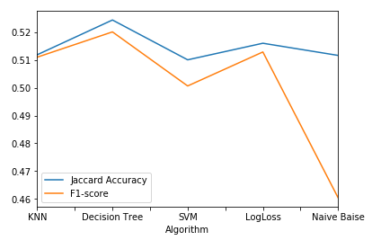
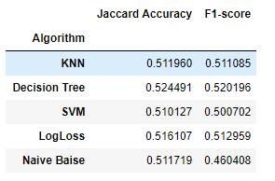
Methodology
Algorithm with its accuracy

Slide 8
Thankyou

